Slide 1
TAP EWA – Source Control Training
Introduction to Databases
Jacqui Muller
Notes:
Welcome

Slide 2
What is a Source Control?
Source control (or version control) is the practice of tracking and managing changes to code.

Slide 3
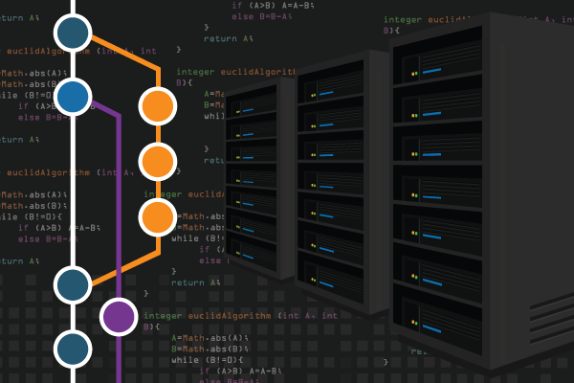
Components
Repositories
Branches
Clones
Commits
Pushes
Pulls
Stashes
Blames

Slide 4
Important Commands
Git clone
Git init
Git add
Git commit
Git push
Git fetch
Git pull

Slide 5
Thank You
Q&A

